Slide 1
Medication Adherence: Identifying Barriers and Advancing Adherence to Improve Health Outcomes USPHS Scientific and Training Symposium May 20th 2015, Atlanta, GA CAPT Carmen C. Clelland, PharmD, MPA Associate Director, Tribal Support Unit Centers for Disease Control and Prevention

Slide 2
Objectives
Identify the health consequences of non-adherence to medication therapy and the impact
Evaluate the current barriers to adherence to medication therapy
Describe public health strategies in collaboration with their health care provider team to increase awareness of non-adherence and identify public health methods that may improve adherence in chronic diseases commonly associated with non-adherence.

Slide 3
“Keep a watch…on the faults of the patients, which often make them lie about the taking of things prescribed. For though not taking disagreeable drinks, purgative or other, they sometimes die.”
Hippocrates, Decorum

Slide 4
Drugs don’t work in patients who don’t take them
- C. Everett Koop, M.D.

Slide 5
Benjamin, Regina M., MD, Troyen Brennan, MD, Ray Bullman, Tom Hubbard, Kathleen Jaeger, J. Mark Jackson, MD, Lee Jones, Jonathan Marquess, National Rosacea Society, Perry Robbins, MD, and Peggy Yelinek. Editorial. Media Planet: Patient Adherence Mar. 2012, 2nd ed.: 1-12. Mediaplanet.com. Media Planet U.S.A., Mar. 2012. Web. 25 Oct. 2013. <http://doc.mediaplanet.com/all_projects/7711.pdf>.

Slide 6
Surgeon General Perspective
“Remarkably, older adults with five or more chronic conditions have, on average, 50 prescriptions filled, see 14 different physicians, and make 37 office visits per year.”
Public Health Reports (125)

Slide 7
Adherence
Adherence is as “the extent to which a person’s behavior coincides with a medical or health advice.”
Managing medication adherence = improved outcomes
complex, but, interesting implications for health practitioners
Treatment → Adherence → Outcomes
Fairman & Motheral, J Man Care Pharm, 2000
Brown & Bussell, May Clin Proc, 2011

Slide 8
World Health Organization
“Increasing the effectiveness of adherence interventions may have a far greater impact on the health of the population than any improvements in specific medical treatments”
Sabate, Adherence to Long-Term Therapies: Evidence for Action, 2003

Slide 9
The costs of nonadherence
Over $100-105 billion dollars annually
125,000 lives every year
83.7 million additional prescriptions costing $3.52 billion.
50% of all medication use
Osterberg & Blaschke, N Engl J Med, 2005
Amos Adler, 2008
IMS , 2013

Slide 10
Adherence Generalization
One-third of patients are compliant
One third of patients are non-compliant because of misunderstanding of treatment plans
One-third of patients are non-compliant as an informed conscious choice to be non-compliant
Redman, B. (1984). The process of patient education. 5th Ed. St. Louis: C V Mosby Co.

Slide 11
Adherence Generalization (cont)
One-sixth come close to perfect adherence
One-sixth take nearly all doses
One-sixth miss occasional daily dose (inconsistent)
One-sixth take drug holidays three or four time a year
One-sixth take monthly drug holidays
One-sixth take few or no doses with the impression of being adherent
N. Engl. J Med 355:5

Slide 12
Polypharmacy
Defined as the total number of different medications a patient takes concomitantly
Usually defined as 5 or 6 medications or more concomitantly
Satish et al, Am Geriatr soc, 1996
Hanlon et al, Am J Med, 1996
Jorgensen et al, Annal Pharmacother, 2001

Slide 13
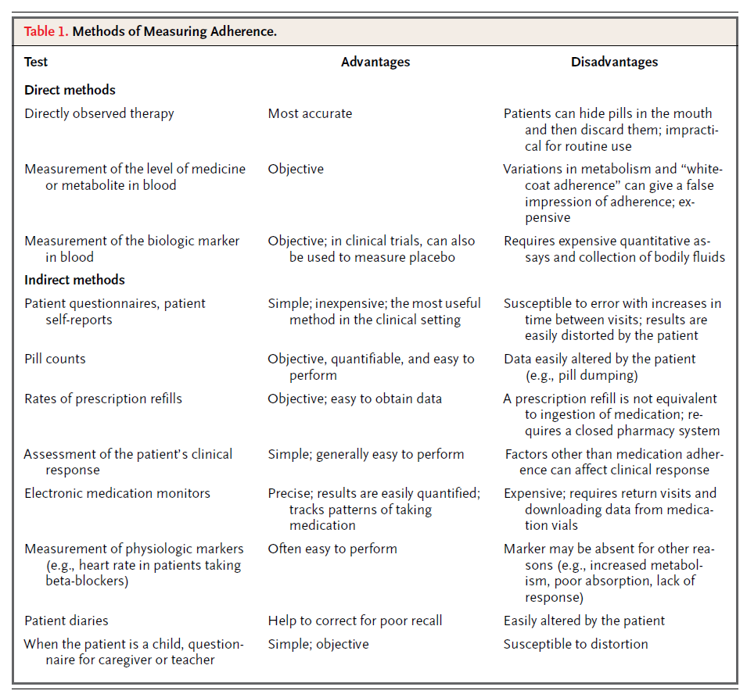
Osterberg, Lars, and Terrence Blaschke. "Adherence to Medication." New England Journal of Medicine 353.5 (2005): 487-97. Print.
License for use received 10-9-2012

Slide 14
Drug Adherence
Product persistency curves
after 1 year as much as a 50 percent decline
after 5 years, compliance as low as 29% to 33%
greatest declines in first six months
Marquess, Jonathan G., PharmD, CDE. "Partnering With Your Community Pharmacist." Editorial. Media Planet: Patient Adherence Mar. 2012, 2nd ed.: 7. Mediaplanet.com. Mediap Planet U.S.A., Mar. 2012. Web. 25 Oct. 2013. <http://doc.mediaplanet.com/all_projects/7711.pdf>.
Permission for use received

Slide 15
Persistence of Therapy - Diabetes Medications (IHS)

Slide 16
Persistence of Therapy - Cardiovascular Medications (IHS)

Slide 17
Comparison of Adherence for MPR at 90, 180 and 270 Days for CV Meds
As this graph shows, from day 90 to 270 of the initial prescription date, adherence dropped from about 82% to around 40%.
With time, average % decrease for each class was about 40%
Graph reproduced with permission from Winslow Indian Health Care Center (WIHCC)

Slide 18
Comparison of MPR LOT ranges and mean LDLc (mg/dL)
Individual 95% CIs For Mean Based on
Pooled StDev
Level N Mean StDev --+---------+---------+---------+-------
<0.50 5 121 38 (-------------*------------)
>0.75 130 86 29 (--*--)
0.5 to 0.75 17 91 31 (-------*------)
--+---------+---------+---------+-------
80 100 120 140
*(ANOVA p=0.034)
Tukey’s Post Hoc Comparator Adherence Range <0.5 versus:
>0.75 mean LDLc -35 mg/dL (CI:-67 to -3)
0.5 to 0.75 mean LDLc -66 mg/dL (CI:-66 to 6)

Slide 19
Comparison of adherence and likelihood of LDLc measure, at Goal, and Avg LDLc
 | Non-Adherent (MPR LOT ≤ 0.75) | Adherent (MPR LOT > 0.75) | Diff | 95% CI | P-value
LDLc measured | 22/91 (54%) | 130/215 (61%) | 7% | -23 to 10 | 0.422
LDLc < 100 mg/dL | 9/41 (22%) | 90/215 (42%) | 20% | -34 to -6 | 0.006
Average LDLc (mg/dL) | 98 (SD 34) | 86 (SD 29) | 12 | -1 to 28 | 0.135*
Using > 0.75 MPR over the length of therapy (LOT) as “adherent”, adherent patients were more likely to have an LDLc < 100 mg/dL (Note: patients without an LDLc measured were considered not at goal)
There was a trend for adherent patients to be more likely to have an LDLc measured and have a lower avg LDLc value, but these was not statistically significant (Type II error because of small sample size: only 22 pts who were non-adherent had an LDLc measured)

Slide 20
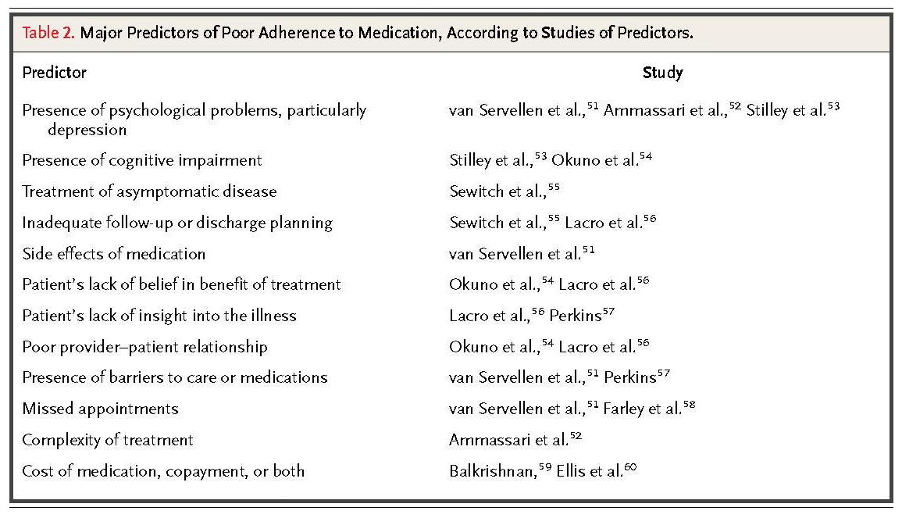
Osterberg, Lars, and Terrence Blaschke. "Adherence to Medication." New England Journal of Medicine 353.5 (2005): 487-97. Print.
License for use received 10-9-2012

Slide 21
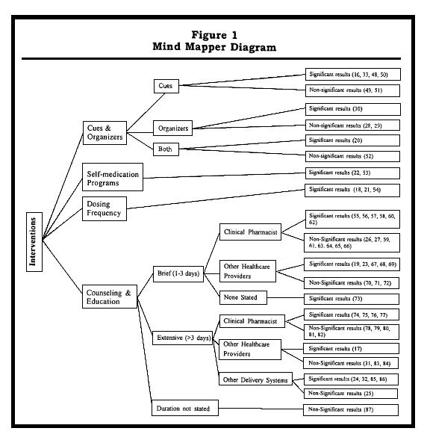
Russell, Cynthia L., PhD, RN, Vicki S. Conn, PhD, RN, FAAN, and Peeranuch Jantarakupt, PhD, RN. "Older Adult Medication Compliance: Integrated Review of Randomized Controlled Trials." Am J Health Behav. 30.6 (2006): 636-50. Print. Figure 1 Page 644
Permission for use received on 10-4-2012

Slide 22
Patients at higher risk (summary)
Patient who take five or more medications
Patients who take 12 or more doses per day
Patients whose medication regimen has changed four or more times in a year
Patients who have more than three chronic diseases
Patients who have a history of not adhering
Patients who take drugs that require therapeutic monitoring
Gray, R. (2006) Triwest Healthcare Alliance

Slide 23
Older Adult Medication Compliance
Only self-medication programs and changing dosing frequency showed consistent improvement in medication compliance
A majority of these studies utilized a combination of interventions
Technology enhanced interventions did not appear to dramatically alter compliance
Further evaluation of the specific contribution of each type of intervention on medication compliance is needed

Slide 24
Pharmacists and Healthcare Team Impact (cont)
Pharmacists should routinely explore barriers to medication adherence, including reasons that are primarily logistical, motivational or emotional.
Minimize the stressful aspect of appointments and make them more conducive to patients having information needs met. (70% of patient may be uncomfortable asking questions.)
Allocating time in appointments for questions
Providing patients with question prompt sheets

Slide 25
Pharmacists and Healthcare Team Impact (cont)
More aggressive assessment and encouragement by health care providers to self-monitor
Overcome “myths” or perceptions
Should have breaks from medications
Medication are addictive
Finding alternatives for those living in a resource strapped environment elicited stress and eroded optimal self-care

Slide 26
Pharmacists and Healthcare Team Impact (cont)
Understanding of community life and helping patients to appropriately engage and utilize the health care system and local community resources
Incorporating culturally and linguistically appropriate methods tailored to individuals' needs
Acknowledge patients who successfully manage their medication-taking behavior in spite of difficult life circumstances

Slide 27
PHS Pharmacy Report to the U.S. Surgeon General
Pharmacist Integration as Health Care Providers
Evidenced-Based Alignment with Health Reform

Slide 28
Public Health Response
Combined approach by healthcare disciplines that supports improved approaches to addressing medication non-adherence.
Increase focus on minority populations and the increased risk of non-adherence and under utilization of chronic prescription medications.
Improved labeling to address adherence and issues involved with medications
Increase of pharmacist resources and payments for clinicians improving medication adherence.

Slide 29
Public Health Response
Identifying a common language to address medication non-adherence:
Defining adherence
Pill burden
Common measure consistent for measuring adherence
Role of the healthcare provider

Slide 30
Public Health Response
Tools
Common screening questionnaire
Method for determining complicated regiments/scoring system
Identify social and new media that can assist with adherence
General guidance when adding new medication to already complicated regimens

Slide 31
